Slide 1
BI Unit 2- Part 2 Topic: Business Intelligence Architecture
Topic: Data Mining, its Properties and Tasks
Presented by: Drashti Shrimal1 Topic: Data Mining, its Properties and Tasks

Slide 2
Topics :
- Differentiate between DWH and Data Marts
- ELT
- Differentiate between ELT and ETL
- Advantages of ELT
- Data Lakes

Slide 3
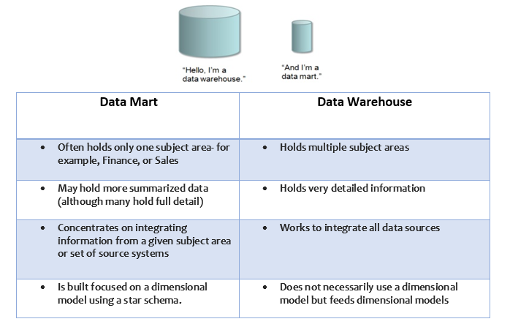
Differentiate between DWH and Data Marts

Slide 4
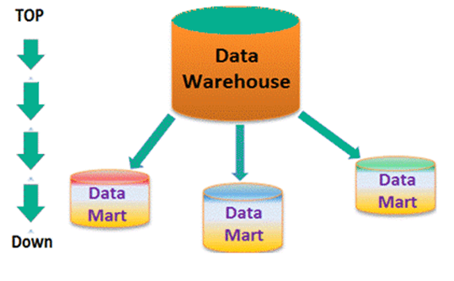
Differentiate between DWH and Data Marts

Slide 5
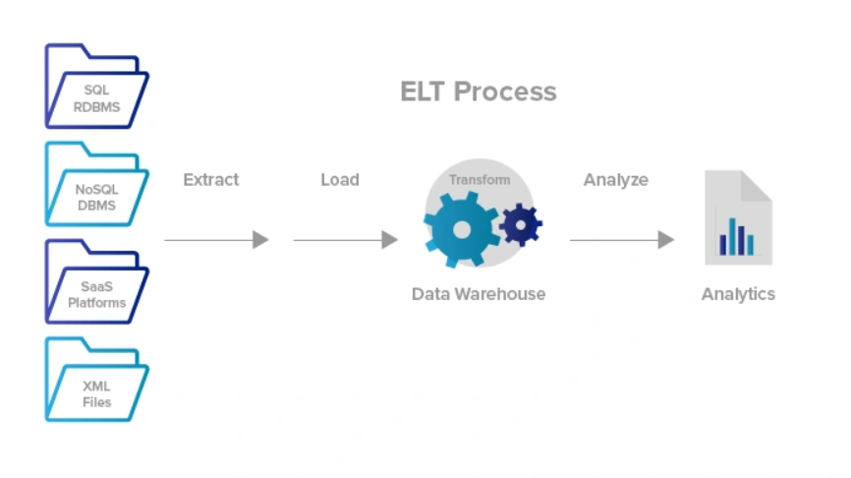
ELT

Slide 6
ELT
ELT stands for "Extract, Load, and Transform." In this process, data gets leveraged via a data warehouse in order to do basic transformations.
That means there's no need for data staging.
ELT uses cloud-based data warehousing solutions for all different types of data - including structured, unstructured, semi-structured, and even raw data types.

Slide 7
ELT
The primary advantage of ELT over ETL relates to flexibility and ease of storing new, unstructured data.
Other benefits:
#1: High Speed
#2: Low-Maintenance
3#: Quicker Loading

Slide 8
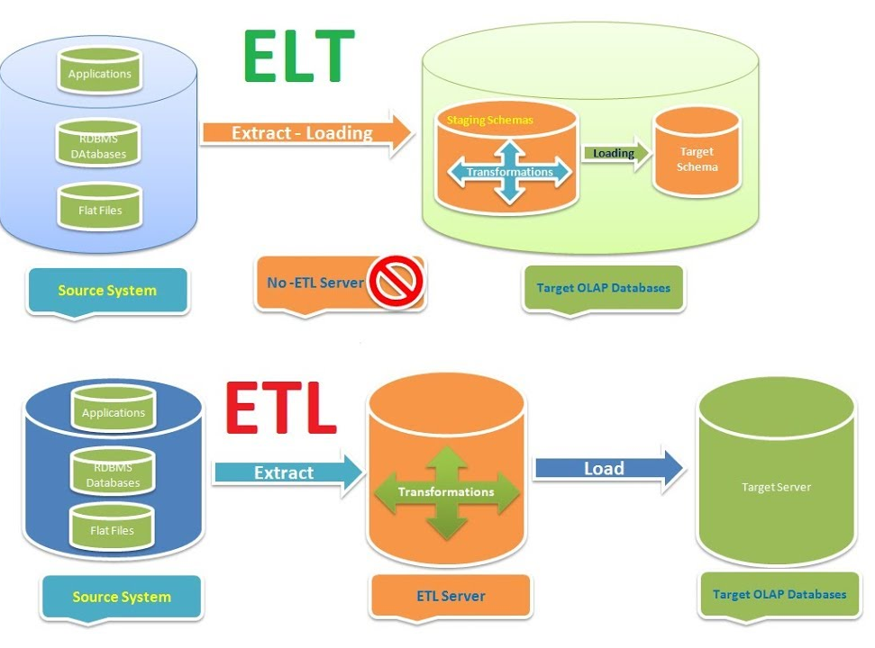
ELT and ETL

Slide 9
ELT and ETL
ETL stands for Extract, Transform, and Load, while ELT stands for Extract, Load, and Transform.
In ETL, data flow from the data source to staging to the data destination.
ELT lets the data destination do the transformation, eliminating the need for data staging.
ETL can help with data privacy and compliance, cleansing sensitive data before loading into the data destination, while ELT is simpler and for companies with minor data needs.

Slide 10
Data Lake
A data lake is a centralized repository that allows you to store all your structured and unstructured data at any scale.
Examples. Many companies use cloud storage services such as Google Cloud Storage.

Slide 11
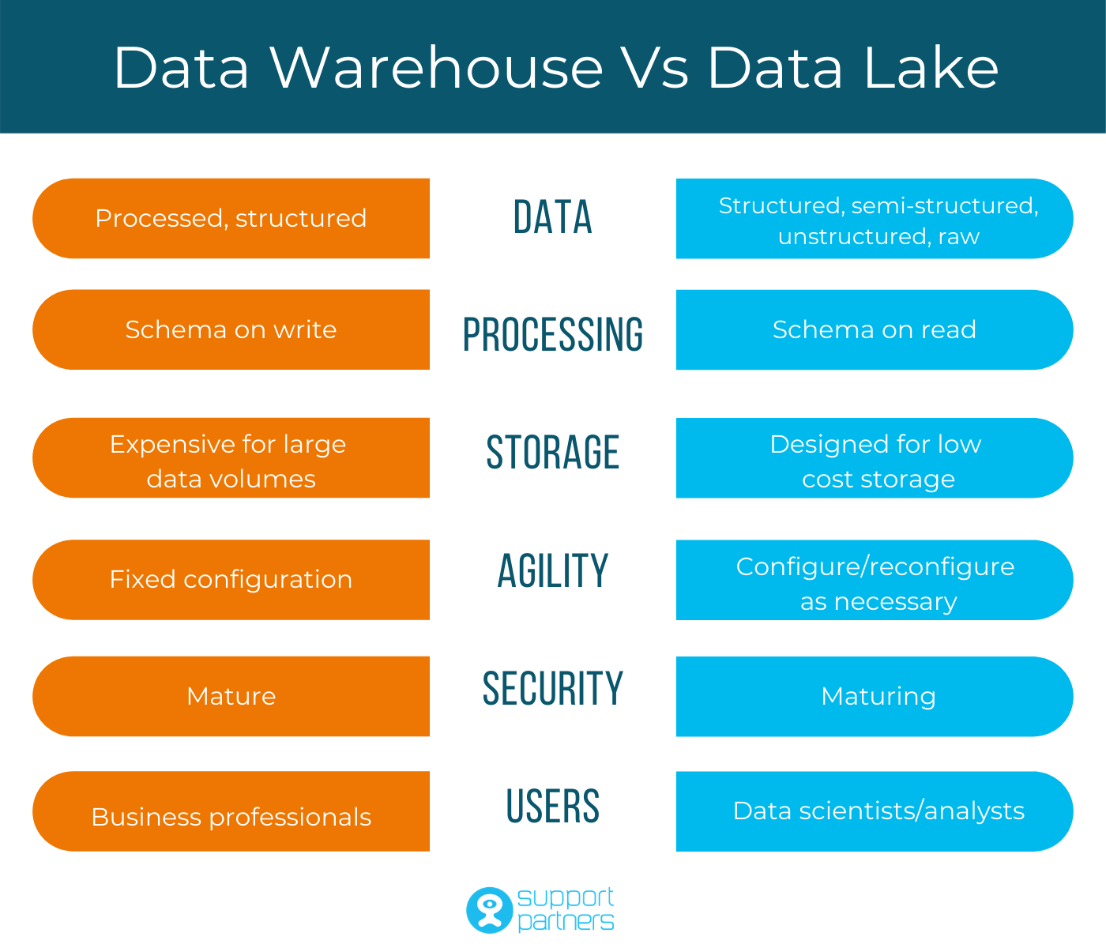
DWH and Data Lake

Slide 12
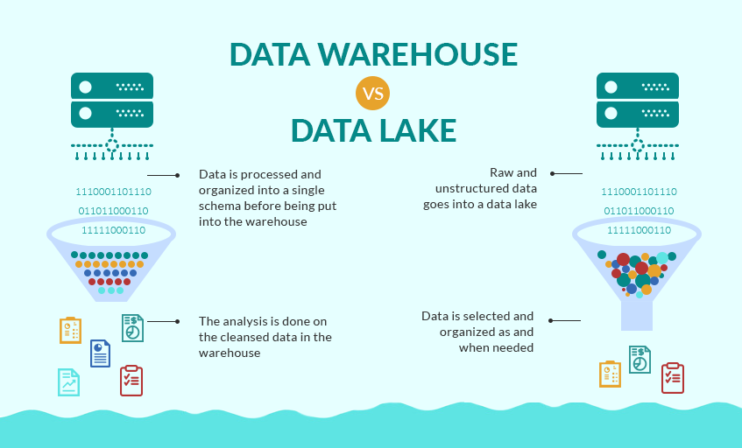
DWH and Data Lake

